Slide 1
Advanced CPT (Java)
240-321, Semester 2, 2004-2005
2. Simple Java Programs
(Chapters 1-3, D&D)
Objectives
  give some simple examples of Java applications and applets

Slide 2
Contents
1. Steps in Writing a Java Application
2. Hello.java
3. A Better Programming Environment?
4. Comparison.java
5. Steps in Writing a Java Applet
6. WelcomeApplet.java

Slide 3
1. Steps in Writing a Java Appl.
text file holding the application
Foo.java
javac Foo.java
call the Java compiler
Foo.class
class file holding
Java bytecodes
java Foo
execute the class using
the Java runtime system
(the JVM)

Slide 4
2. Hello.java
import java.io.*;
public class Hello {
public static void main(String args[])
{
System.out.println(“Hello Andrew”);
}
} // end of class

Slide 5
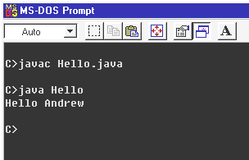
Compile & Run

Slide 6
Notes
import imports pre-defined classes from the java.io package. * means “all classes”
All Java applications must have a main() function (method)
  static means the method is not part of the class
  public means visible everywhere
  args[] stores command line arguments as an array of strings (not used here)
continued

Slide 7
The Java file (e.g. Hello.java) must contain a public class with the file’s name (e.g. Hello class).
  the class is not being used in this example
  main() is not part of the class, but must be placed inside the class
  this is a confusing piece of design
continued

Slide 8
System.out is the standard output stream object.
System.out.println() is a function (method) understood by the object.
writes to screen
via output stream
out
call
Hello
main() calls
System.out.println(…)
object with
a println()
method

Slide 9
3. A Better Programming Environment?
When first learning Java, it is best to use a simple programming environment
  it forces you to understand how the language works
I write/compile/execute my programs using a simple configuable text editor called EditPlus
  see http://www.editplus.com
continued

Slide 10
Useful EditPlus features
  it will format Java code automatically
  colour-coded display of code
  it is possible to add calls to javac, java, appletviewer to the EditPlus menu
    no need to leave the editor to compile/run
  there is an optional window that show the output from running Java code

Slide 11
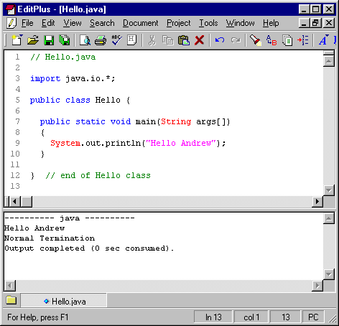

Slide 12
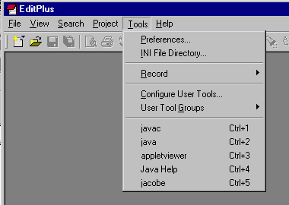
EditPlus Tools Menu

Slide 13
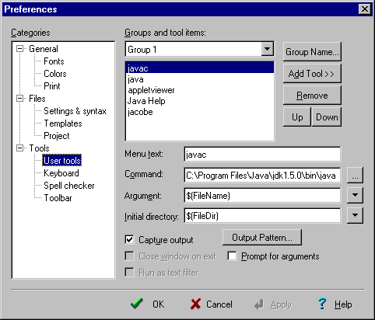
javac.exe

Slide 14
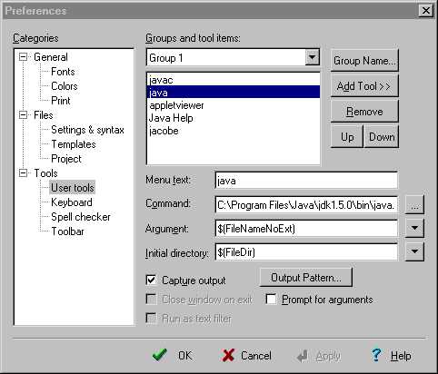
java.exe

Slide 15
4. Comparison.java
D&D, Fig. 2.17, p.58
import javax.swing.JOptionPane; // GUI dialogs
public class Comparison
{
public static void main( String args[] )
{ String firstNumber,secondNumber,result;
int number1,number2;
// read user numbers
firstNumber = JOptionPane.showInputDialog(
"Enter first integer:");
secondNumber = JOptionPane.showInputDialog(
"Enter second integer:" );
:

Slide 16
// convert numbers
number1 = Integer.parseInt( firstNumber );
number2 = Integer.parseInt( secondNumber );
result = "";
if ( number1 == number2 )
result = number1 + " == " + number2;
if ( number1 != number2 )
result = number1 + " != " + number2;
if ( number1 < number2 )
result = result + "\n" +
number1 + " < " + number2;
if ( number1 > number2 )
result = result + "\n" +
number1 + " > " + number2;
if ( number1 <= number2 )
result = result + "\n" +
number1 + " <= " + number2;
:

Slide 17
if ( number1 >= number2 )
result = result + "\n" +
number1 + " >= " + number2;
// Display results
JOptionPane.showMessageDialog(
null, result, "Comparison Results",
JOptionPane.INFORMATION_MESSAGE );
System.exit( 0 );
} // end of main()
} // end of Comparison class

Slide 18
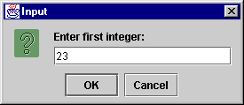
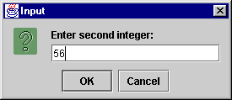
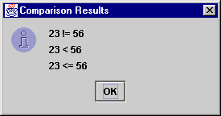
Compile & Run
$ javac Comparison.java
$ java Comparison
$

Slide 19
Notes
The Comparison class is not used
  the program is really just a single main() function (method)
continued

Slide 20
showInputDialog() and showMessageDialog() are simple (but quite flexible) methods for reading/writing input in dialog boxes
  defined inside the JOptionPane class
continued

Slide 21
Notice the use of familiar C/C++ control structures (e.g. if, while) and data types (e.g. int, double)
“...” + “...” means concatenation
(put strings together)
String is a pre-defined class for strings.
int is a built-in type (just like C’s int).

Slide 22
Calling Methods
Methods are defined in classes.
Syntax for calling a method:
Class.method-name
  or object.method-name
  e.g. JOptionPane.showMessageDialog(...);
    this calls the showMessageDialog() method in the class JOptionPane

Slide 23
The Integer Class
int is a C-like built-in type
Integer is a Java class for integers
  used when integer methods are required
    Integer.parseInt() converts a string to int

Slide 24
5. Steps in Writing a Java Applet
AFoo.java
text file holding the applet
javac AFoo.java
call the Java compiler
AFoo.html
AFoo.class
class file holding
Java bytecodes
Web page that
calls AFoo.class
appletviewer AFoo.html
execute the applet using the Java runtime system (the JVM)

Slide 25

Using a browser
AFoo.html
AFoo.class
Web page that calls
AFoo.class
browser downloads Web page
and Java class
For Java 2, the Java Plug-in is required, or use the
Opera browser
execute the applet using
the Java runtime system
(the JVM)

Slide 26
6. WelcomeApplet.java
D&D, fig. 3.6., p.86
import javax.swing.JApplet;
import java.awt.Graphics;
public class WelcomeApplet extends JApplet {
public void paint(Graphics g)
{
g.drawString(“Welcome Andrew”, 25,25);
}
}

Slide 27
WelcomeApplet.html
<html>
<head>
<title>Welcome Andrew</title>
</head>
<body>
<applet code=“WelcomeApplet.class”
width=300 height=30>
[Java Welcome applet runs here]
</applet>
</body>
</html>

Slide 28

Compile & Run
$ javac WelcomeApplet.java
$ appletviewer WelcomeApplet.html

Slide 29
Notes
The structure of an applet is quite different from a Java application
  there is no main() function
  the “top-level” class must inherit from JApplet or Applet

Slide 30
Inheritance
extends
  object oriented inheritance
  The WelcomeApplet class inherits most of its abilities from the JApplet class
  WelcomeApplet is the subclass / derived class
  JApplet is the superclass / base class

Slide 31
Event Handling
Pre-specified JApplet methods are called at certain times and when certain ‘events’ happen:
  paint() is called at applet start-up and whenever the window containing the applet needs to be redrawn
  Welcome redefines paint(), but it is still called in the same way

Slide 32
The Graphics Context
g.drawString()
  g is the graphics object representing the look of the applet on screen: called the graphics context for the applet
applet
drawing
area
:
g.drawString(...);
:
g
WelcomeApplet
code
browser

Slide 33
Browser Execution
Microsoft IE and Netscape do not directly support Java 2.
A common solution is to use the Java plugin, available from Sun
  a drawback is that it requires the Web page containing the applet to contain more complicated tags (and JavaScript code) so that the applet can run inside Netscape and Microsoft IE
continued

Slide 34
A better solution is to use the Opera browser:
  free from http://www.opera.com
  it comes with JRE 1.5, the latest version of the Java Runtime Environment, or it can be linked to the JRE already on your machine
  there is no need for a Java plugin
  Opera is very fast, small-size, and supports many networking standards
continued

Slide 35
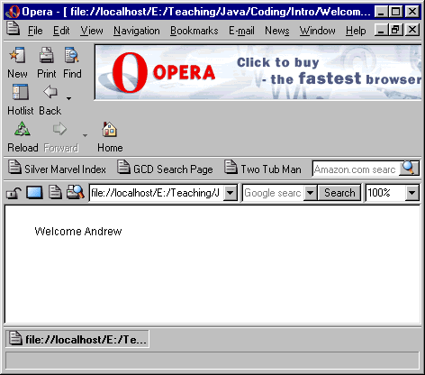
Load WelcomeApplet.html

